Slide 1

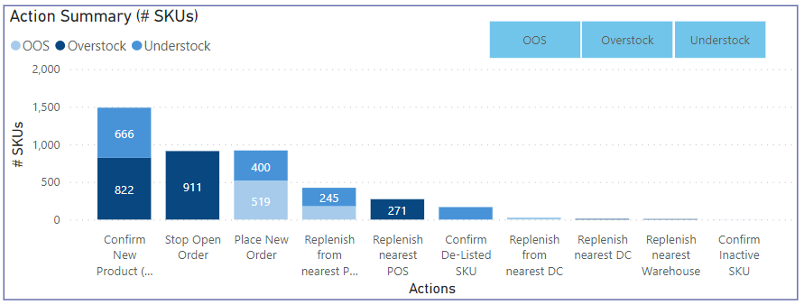
Intelligence and automation – Inventory Re-balancing across warehouses
Objective :
Currently, warehouses face a deviation in stock levels compared to pre-set stock norms, leading to loss of sales and working capital
Planning team wants to identify & analyse Over/Under Stock risks, providing action plan for mitigations with alerts to reduce loss of sales, working capital and mitigate LOGD risks
Analytics team created a working model to recommend re-distribution of inventory across warehouses, using Python and Automation techniques
Step 1 : EDA (Exploratory data analysis) and data preparation
Improve data quality by statistical imputation of null values and outlier removal
Create ADS (Analytical dataset) by merging relevant data from different sources
Step 2 : Calculation of stock imbalance
Calculate DOI as per last week SKU demand
Identify overstock/understock at warehouse-SKU-day level and calculate the volume
Flag SKUs which are de-listed, inactive, non-moving and slow-moving
Step 3 : Efficient re-distribution of stock
Using Google distance matrix API, calculate the road distance between warehouses
If source warehouse is Overstock, then identify nearest warehouses which are understock and recommend distribution
If source warehouse is understock, then identify the nearest overstock warehouse which can satisfy the required demand
Step 4 : Dashboard
Summarise all redistribution actions to be taken across warehouses
Track stock health across months
Enable actions on points like – Production of SKUs with high overstock volume can be halted or POs be put on hold
Week-level regression accuracy of 75% is achieved

